Slide 1
Connect 4 AI: Advanced Strategy Using MCTS and other Approaches
Exploring Monte Carlo Tree Search and other game-solving approaches with OpenMP Parallelism
Nischal H S : PES1UG21CS393
Puneet Sheokand : PES1UG21CS457

Slide 2
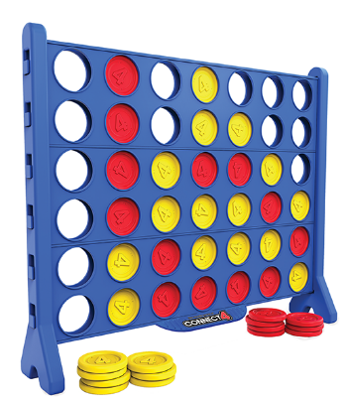
Connect 4 AI
Problem: Developing strong AI for Connect Four requires efficient search algorithms.
Goals:
Implement and compare Minimax and Monte Carlo Tree Search (MCTS).
Enhance their efficiency using parallel computing (OpenMP & Pthreads) and benchmark it

Slide 3
Connect 4 AI
Contributions:
Nischal: Connect 4 game logic, MCTS and MCTS parallelisation
Puneet: MCTS heuristics, Minimax and Minimax parallelisation

Slide 4
Monte Carlo Tree Search (MCTS)
MCTS is used for decision making in game AI, like Connect 4.
Simulation & Statistics: Simulates random games to estimate win probabilities.
Exploration & Exploitation: Balances trying new moves with choosing the best ones.

Slide 5
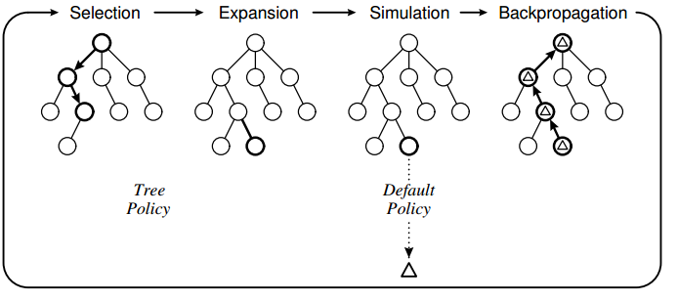
Monte Carlo Tree Search (MCTS)
It involves four main steps:
1. Selection: Traverse from root to a leaf node using a selection policy.
2. Expansion: Add one or more child nodes to expand the tree.
3. Simulation: From the new nodes, simulate random gameplays to get possible outcomes.
4. Backpropagation: Update the nodes with the results of the simulation.

Slide 6
Code Insights and AI Gameplay Strategy
Various classes manages the game state, player moves, and child nodes for the tree.
Each node in the tree represents a possible state of the board. Expansion is done by applying a player's move.
Simulation uses random moves + heuristics to estimate the win probability from that state. Results influence AI decisions.
The AI uses OpenMP for parallel processing during the simulation phase, enhancing performance and decision speed.

Slide 7
Parallelising MCTS
2 Approaches:
Naive approach- omp for over the simulations loop while having critical sections.
Not great- critical sections are compute heavy
Subtree approach- assign a subtree to each thread, which do not overlap with each other, hence almost all operations are independent(except updating root)

Slide 8
MinMax Algorithm and Alpha-Beta Pruning
MinMax Algorithm Overview:
Decision-making algorithm used in game playing
Evaluates all possible future game states
Maximizes the AI's chances of winning while minimizing the player's chances
Alpha-Beta Pruning:
Optimization technique to reduce the number of nodes evaluated in the minimax tree
Allows for efficient pruning of branches that do not affect the final decision
Significantly reduces the computational complexity of the algorithm

Slide 9
AI Move (aiMove, miniMax):
Implements the minimax algorithm with alpha-beta pruning to determine the AI's next move and searches all possible moves to specified depth.
Utilizes heuristic evaluation (tabScore, scoreSet, heurFunction) to assign scores to game states.
Winning Move Detection (winningMove):
Checks the game board for winning combinations of pieces.
Score Calculation (tabScore, scoreSet, heurFunction):
Evaluates the current game state by analyzing various patterns of pieces on the board.
Computes scores based on the number and arrangement of player and opponent pieces.
Applies heuristic evaluation to assign scores to different configurations of pieces.

Slide 10
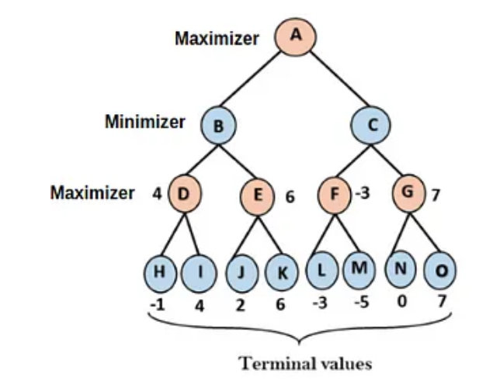
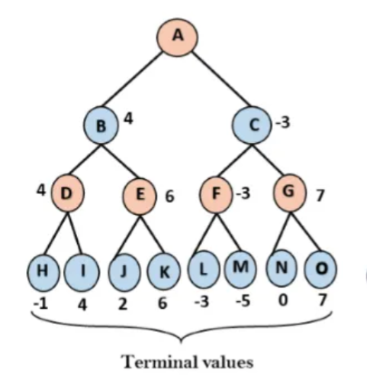
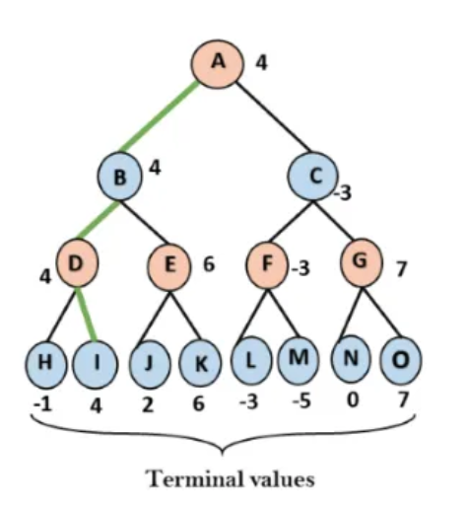

Slide 11
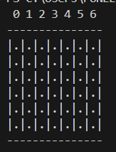
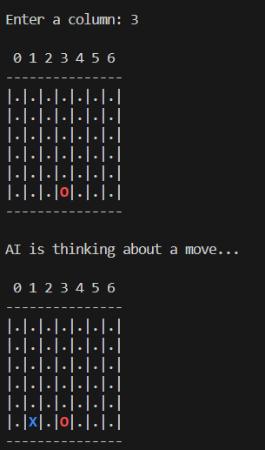
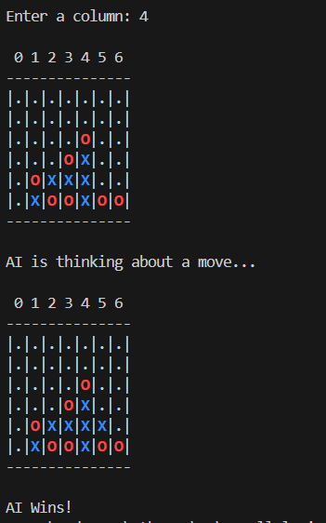
Start
Intermediate
End

Slide 12
Game intelligence- Minimax beats MCTS
Essentially both are doing similar things.
MCTS meant to be used with RL
Minimax does great at exploiting heuristics and efficiently brute forcing

Slide 13
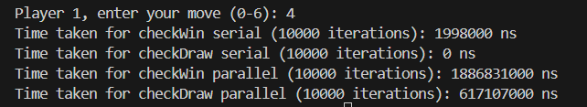
Benchmarking - checkWin and checkDraw (MCTS)
Did expect parallelising to make it worse- low iterations, high threading overhead

Slide 14



Benchmarking - MCTS serial, parallel approach 1, approach 2
As expected, parallel approach 2 does well, whereas approach 1 is not as good and more inconsistent

Slide 15
Benchmarking - MCTS serial, parallel approach 1, approach 2
Approach 1 is between slightly faster than serial to upto 4 times faster, usually the former
Approach 2 is 4-6 times faster than serial

Slide 16



Benchmarking - Minimax
The approach 1 with basic parallelism achieved 2x speed
The approach 2 (subtree backtrack) achieved 4x speed

Slide 17
Conclusions
Minimax outdoes MCTS in intelligence, but MCTS with the right weights and rewards with the help of RL based tuning has great potential
Parallelising with the right approach dramatically improves time required for simulations - 4-6 times in MCTS, can scale with the number of logical cores if we use multiple layers of moves

